Slide 1

EJB

Slide 2

Issues with Distributed Systems
Brief about EJB
A Short History of time: EJB 2.1
EJB 3.0
  Goals
  Annotations

Slide 3

Remote method invocation
Load balancing
Transparent failover
Back-end integration to legacy systems
Transactions
Clustering (state replication across servers)
Dynamic redeployment (upgarde while running)

Slide 4

Clean shutdown
Logging and auditing
Systems management
Threading
Message-oriented middleware
Component lifecycle
Resource pooling

Slide 5

Security
Caching
Etc., etc.

Slide 6

All of these can be thought of as middleware services
Developer of distributed app shouldn’t have to worry about them
  Should concentrate on business logic
  Much too expensive to build from scratch
  Distributed app should be portable across middleware service providers

Slide 7

EJB spec defines standard interfaces between distributed components & their containers

Slide 8

Advantages
  Industry standard
    Vendors design containers to EJB specs
  Portability possible across containers

Slide 9

Server-side components encapsulating application functionality
  Business logic
  DB access
  Integrate with other legacy systems
  Serve multiple clients
    Browsers
    Desktop apps
    Other EJBs
    Web app components (e.g, Servlets)
    Web service clients

Slide 10

EJB can be located anywhere, usually on another machine
Use RMI-IIOP for remote invocation of methods
Location transparency
  Client thinks remote EJB is local
Run inside EJB container
    Application servers

Slide 11

EJB Servers provide core services to components:
  Transaction
  Security
  Naming
  Persistence
  Life cycle
  Concurrency
EJB technology enhances:
  Simplified access to services

Slide 12

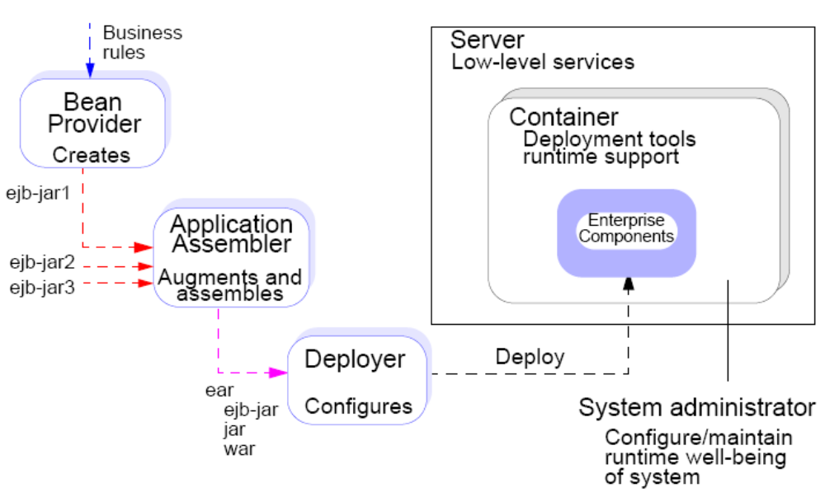

Slide 13


Slide 14

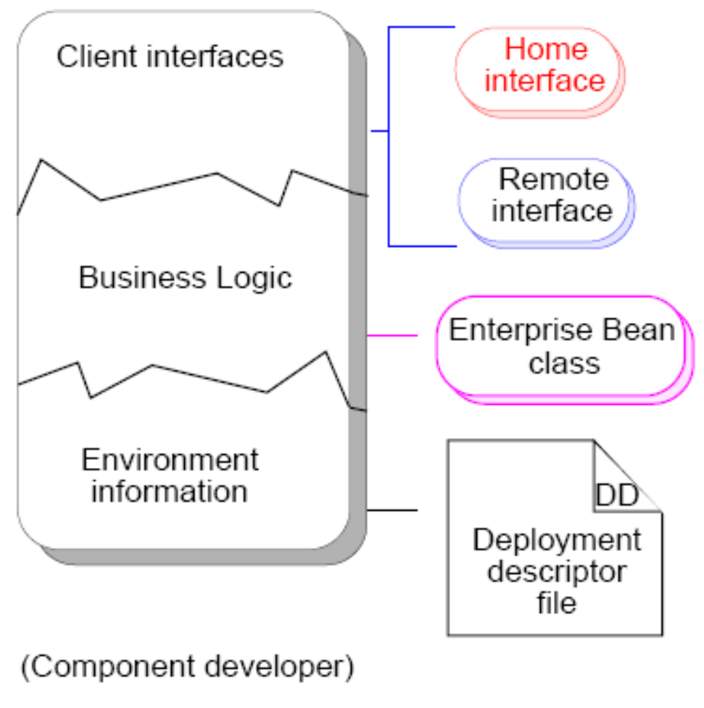
Declarative programming
and customizing

Slide 15
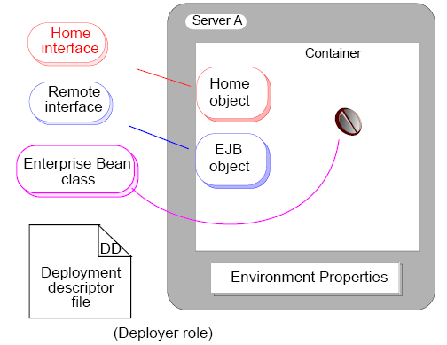
Deploying

Slide 16

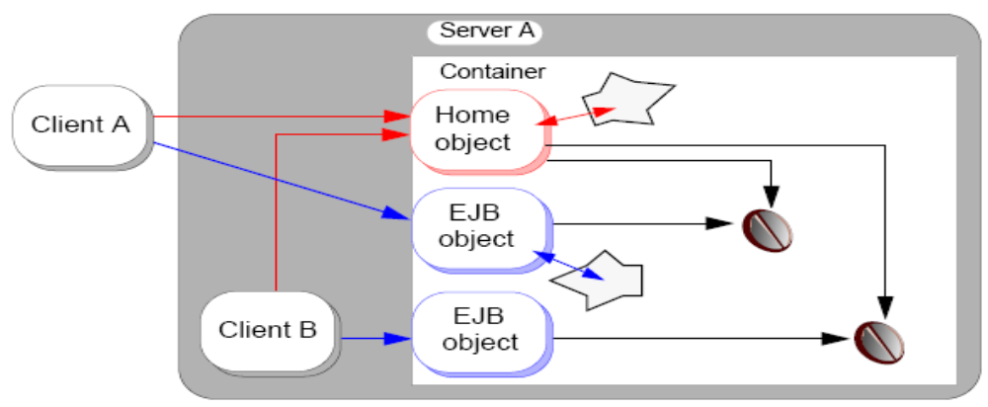
Uniform client access whether local or remote
Home object is a factory for EJBs
EJB object is the remote object for accessing EJBs

Slide 17

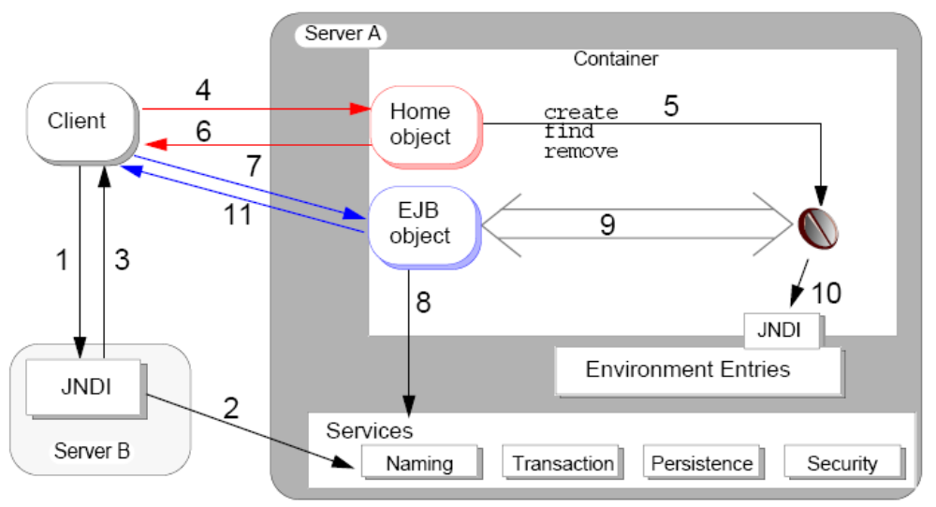

Slide 18

Services:
  Transactions
  Security
  Naming
  Persistence
  Lifecycle
  Concurrency

Slide 19

Can contain multiple beans
Is normally provided by EJB server vendor
Is not visible to the client
Is implemented in different ways by different vendors

Slide 20
Provides some standard services:
  Persistence
  Transaction control
  Security
  EJB instance lifecycle management
  EJB instance identification

Slide 21

Factory interface for the bean:
  Interface provided by EJB developer
  Exposes methods for creating or locating beans
EJB server provides:
  Implementation class
  Stubs and (optionally) skeletons
  One factory per bean class
  Registration of factory with naming service

Slide 22

Proxy interface for the bean:
  Interface provided by EJB developer
  Exposes business methods
EJB server provides:
  Implementation class
  Stubs and (optionally) skeletons
  Instances of as needed

Slide 23

The EJB object is a wrapper object that acts as a proxy to the bean instance.
  Interface provided by bean developer.
  Implementation class generated by vendor tool.
Each business method has a corresponding wrapper method in the EJB object.
  Wrapper method implements container-provided services.

Slide 24

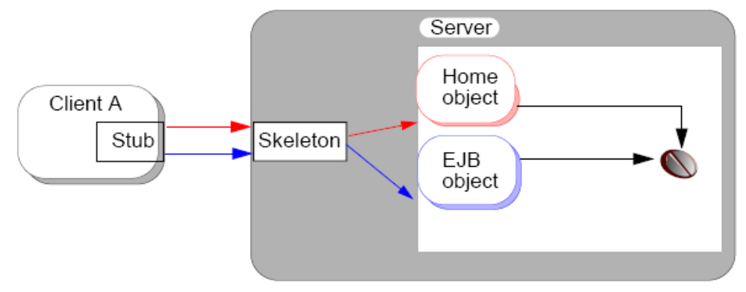
Stub is downloaded from server
Communication between stub and skeleton can be proprietary, yet EJB code is still portable

Slide 25

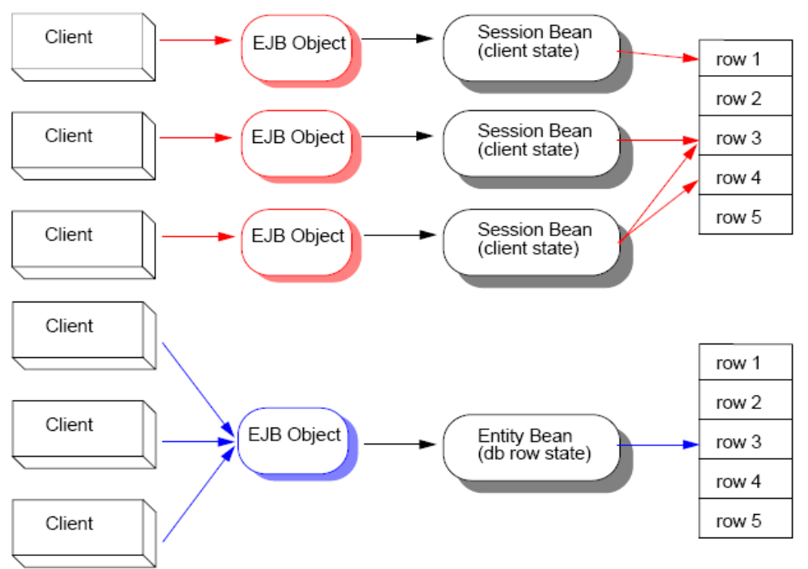

Slide 26
Session Bean | Entity Bean
Private client resource | Accessed by multiple clients concurrently
Client affects Bean’s state | Bean represents state of data
Bean is not persistent; state can be stored in secondary memory | Bean is persistent; state is synchronized with corresponding state of data
Lifetime is controlled by client | Lifetime corresponds to its persistent store
Normally created for use | Normally located for use
Transaction participant (optional) | Transactional by nature

Slide 27

Stateful beans maintain client-specific state across method calls.
  create methods can pass arguments.
Stateless beans do not maintain client state across method calls for the same client.
  create methods are no-args.
  Container can pool stateless Beans since they do not maintain state.

Slide 28

Are persistent objects
Are transactional by nature
Use two management techniques
  Container-managed persistence (CMP)
  Bean-managed persistence (BMP)

Slide 29

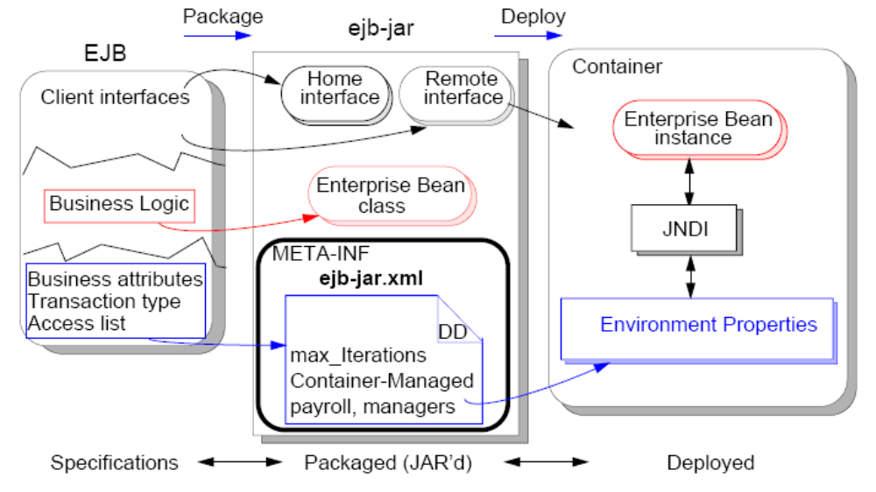

Slide 30

Portable property sheet for the EJB
XML document
Describes various attributes of one or more EJBs:
  Structural information
  Application assembly information
  Declaration of required resources
One deployment descriptor per jar (multiple EJBs)
  META-INF/ejb-jar.xml
Allows for post-compile customization of EJB

Slide 31

Contains classes and DD required by deployer:
  Enterprise bean class
  Home interface class
  Remote interface class
  Primary key class (for entity beans)
  Helper classes
Does not contain:
  Home interface implementation (home object)
  Remote interface implementation (EJB object)

Slide 32


Slide 33

EJB 2.x has become overly complex
To many artifacts for developers
Too many interfaces in EJB 2.x (home, ejb)
Unnecessary exceptions, callback methods
No standard way to define primary key
EJB 3.0 makes another attempt promise reducing EJB’s complexity for developers
Simpler domain models with Plain Old Java Objects (POJOs)

Slide 34

Decrease number of artefacts
  Home interfaces and deployment descriptors
Program annotations introduced in Java 5
Light-weight domain modelling
  Including inheritance and polymorphism
Configuration by exception
Dependency injection
Reduction of checked exceptions
Testing outside the container

Slide 35

Exceptions
  Interface may declare arbitrary exceptions
  Should not throw java.rmi.RemoteException
  EJBException thrown by container
Callbacks and Callback listener Classes
  No callbacks (e.g. ejbCreate(), ejbPassivate()) for lifecycle events required
  Method annotations for callbacks
  Callback listener class may be used instead of callback methods

Slide 36

annotations do not directly affect program semantics
can be inspected through source parsing or by using the additional reflection APIs
define custom annotations
  annotate fields, methods, classes, etc.
used to define
  bean's business interface
  O/R mapping information (specific persistence)
  resource references
  deployment information

Slide 37
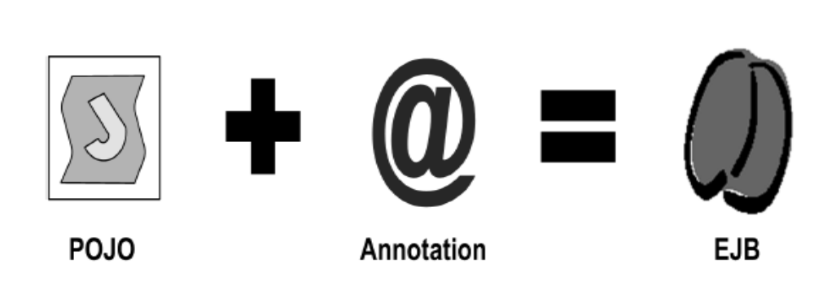
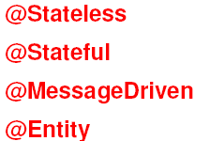

Slide 38

Declarative Programming
Less coding since tool will generate the boiler plate code from annotations in the source code
Eliminates the need for verbose deployment Descriptors

Slide 39

have to change source code each time a configuration change is made

Slide 40


